Slide 1

Penrose platter spin ices
School of Physics and Astronomy
Faculty of Mathematics and Physical Sciences
Masters defence presentation

Slide 2
Overview
Water ice
Frustration
Spin ice
Artificial Spin Ice
Monte Carlo
Discretisation
Software
Statistical Analysis
Square spin ice
Penrose spin ice

Slide 3
Water ice
Calorimetric measurements of water ice by W. F. Giaque resulted in a calculation of entropy which differs from the result theoretically obtained result for an ideal gas.
W. F. Giaque and J. W. Stout, ‘The Entropy of Water and the Third Law of Thermodynamics. Heat Capacity of Ice from 15K to 273K’, J. Am. Chem. Soc., 1936.
The variance was explained by Linus Pauling, who showed that ice possess a finite entropy even at absolute zero with a value 3.4 J/(mol•K) accounting well for the difference.
Linus Pauling, The Structure and Entropy of Ice and of Other Crystals with Some Randomness of Atomic Arrangement, J. Am. Chem. Soc, 1935.

Slide 4
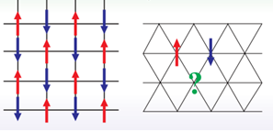
Frustration
Roderich Moessner and Arhur P.Ramirez,
Geometrical frustration,
Physics today, 2006

Slide 5
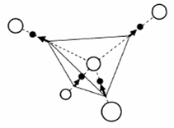
Spin ice
Athermal dynamics of artificial spin ice: disorder, edge and field protocol effects. PhD Thesis. Zoe Budrikis.

Slide 6
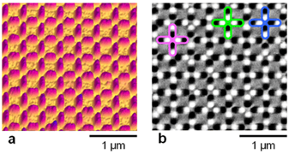
Artificial Spin Ice
R.F. Wang and C.Nisoli.
Artificial spin ice in a geometrically frustrated lattice of nanoscale ferromagnetic islands.
Nature 2006.

Slide 7
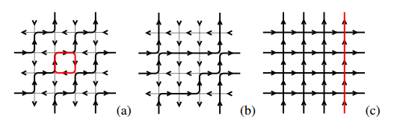
Characteristic phases
Levis, D. and Cugliandolo, L.F.
Thermal phase transitions in Artificial Spin-Ice.
Feb 2003

Slide 8
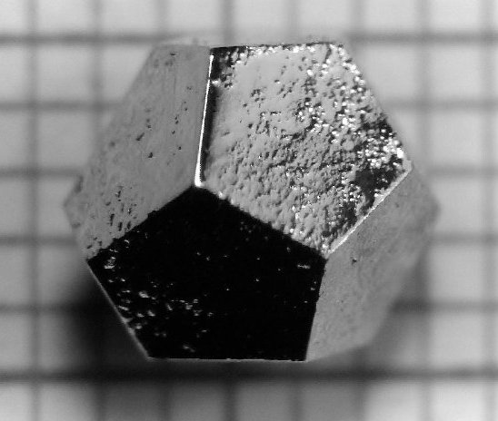
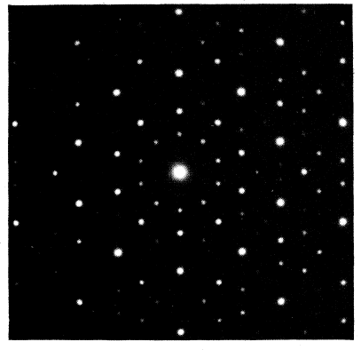
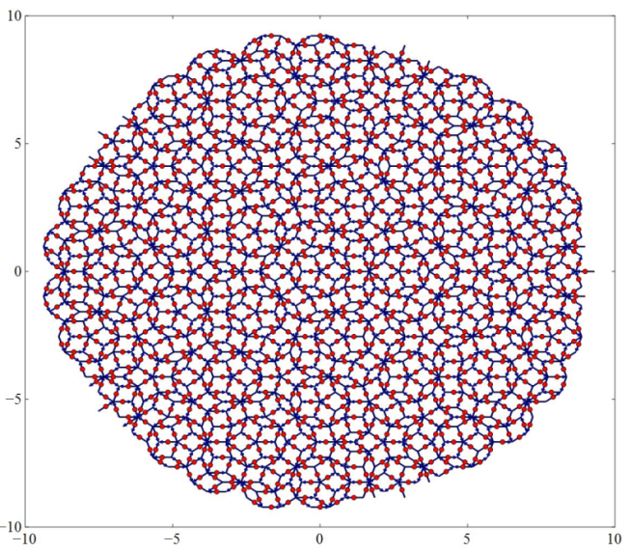
Quasicrystals
Ho-Mg-Zn
Suchitra Sebastian and Ian Fisher.
Phys. Rev. B 59, 308–321 (1999)
PHYSICAL REVIEW B, VOLUME 32,
NUMBER 8, Indexing problems
in quasicrystal diffraction.
15 OCTOBER 1985
Veit Elser
2011 Nobel Prize!

Slide 9
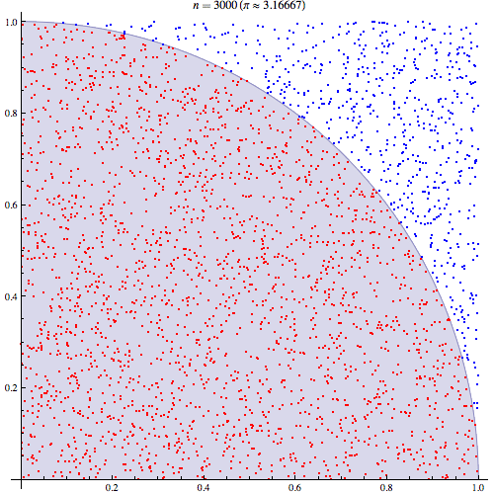
Monte Carlo method
Draw a square then make a circle within it.
Randomly scatter some points over the square.
Count the number of points inside the circle while keeping track of total number of points.
The ratio of the two counts is an estimate of the ratio of the two areas, which is π/4. Multiply the result by 4 to estimate π
Caitlin Jo Ramsey

Slide 10
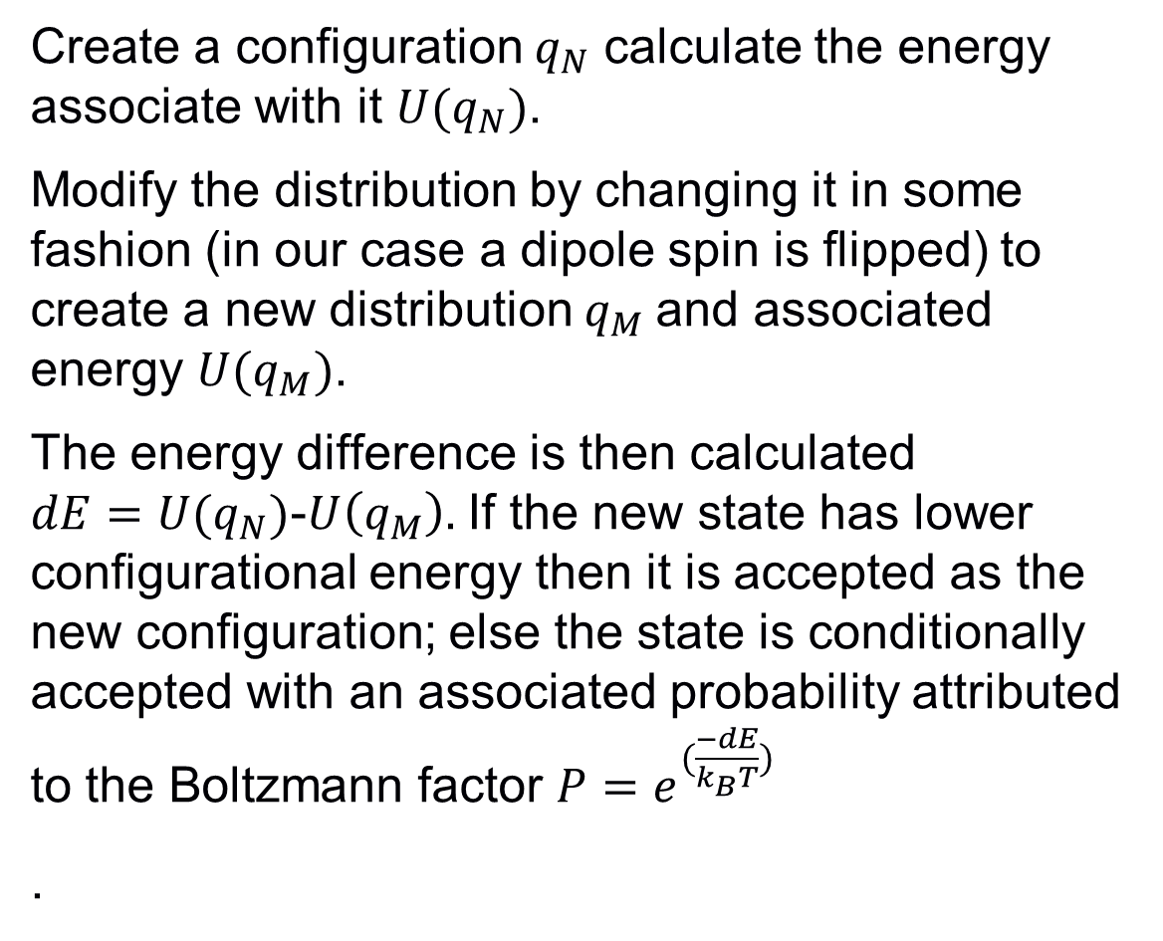
Monte Carlo Metropolis
Create a configuration $q_{N}$ calculate the energy associate with it $U(q_{N})$.
Modify the distribution by changing it in some fashion (in our case a dipole spin is flipped) to create a new distribution $q_{M}$and associated energy $U(q_{M})$.
The energy difference is then calculated $dE=U(q_{N})$-$U\left(q_{M}\right).$ If the new state has lower configurational energy then it is accepted as the new configuration; else the state is conditionally accepted with an associated probability attributed to the Boltzmann factor $P=e^{(\frac{−dE}{k_{B}T})}$
.

Slide 11
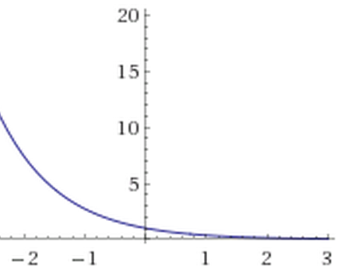
Monte Carlo Metropolis
This equivalent to the probability associated with state N divided the probability of state M.
If the energy difference of the two system states is zero, then the state is accepted with probability of unity.
Otherwise as the energy difference approaches infinity, the probability of acceptance approaches zero.
New configurations with lower energy will always be accepted. System states with greater but similar energy will likely be accepted. Local minima can be escaped as it is possible for the energy to increase.

Slide 12
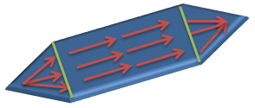
Discretisation

Slide 13
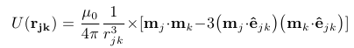
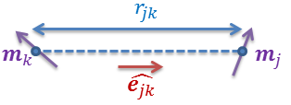
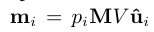
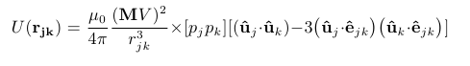
Hamiltonian
Norberto Majlis,
The Quantum Theory of Magnetism,
2007

Slide 14
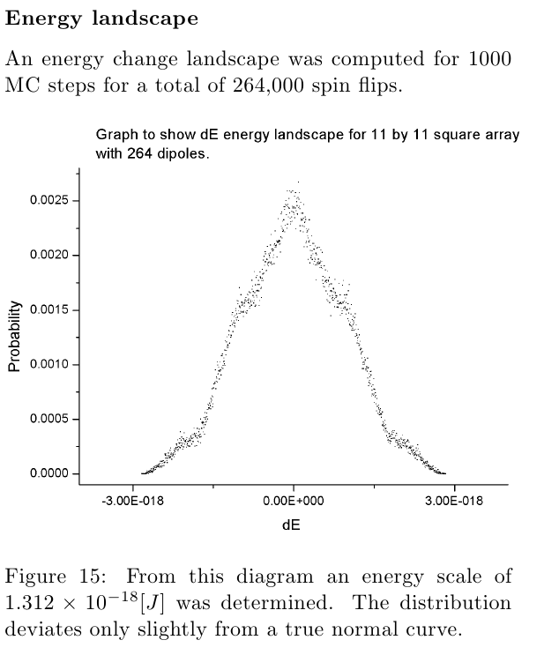
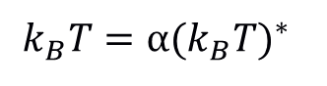
Temperature/Energy scale
High temperature distribution.
$${k_{B}T=α(k_{B}T)}^{∗}$$
MC Time

Slide 15
Software
Simulation group
GUI Graph Monitor
TCP IP
Vertex population and
energy data
Update/Kill commands
MC Process 1
MC Process 2
EVT.csv
Pickled distribution

Slide 16
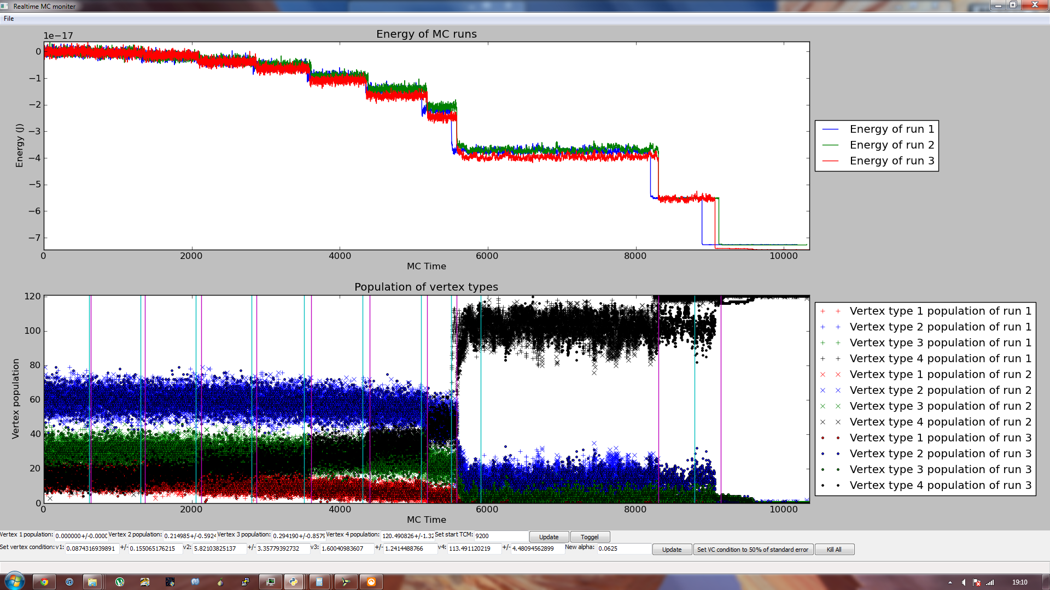
Software
FACULTY OF OTHER

Slide 17
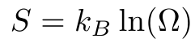
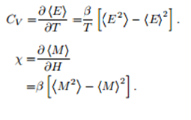
Statistical Analysis
The fluctuation dissipation theorem.
R Kubo,
The fluctuation-dissipation theorem,
Reports on Progress in Physics. 1966.

Slide 18
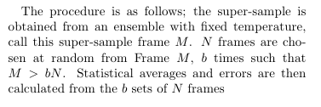
Statistical Analysis
Errors
Two methods:
Combinatorial errors.
Statistical Bootstrapping:

Slide 19
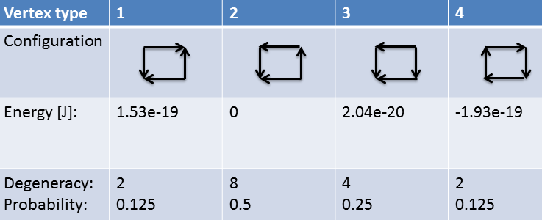
Square spin ice
Results

Slide 20
Square spin ice
Energy landscape

Slide 21
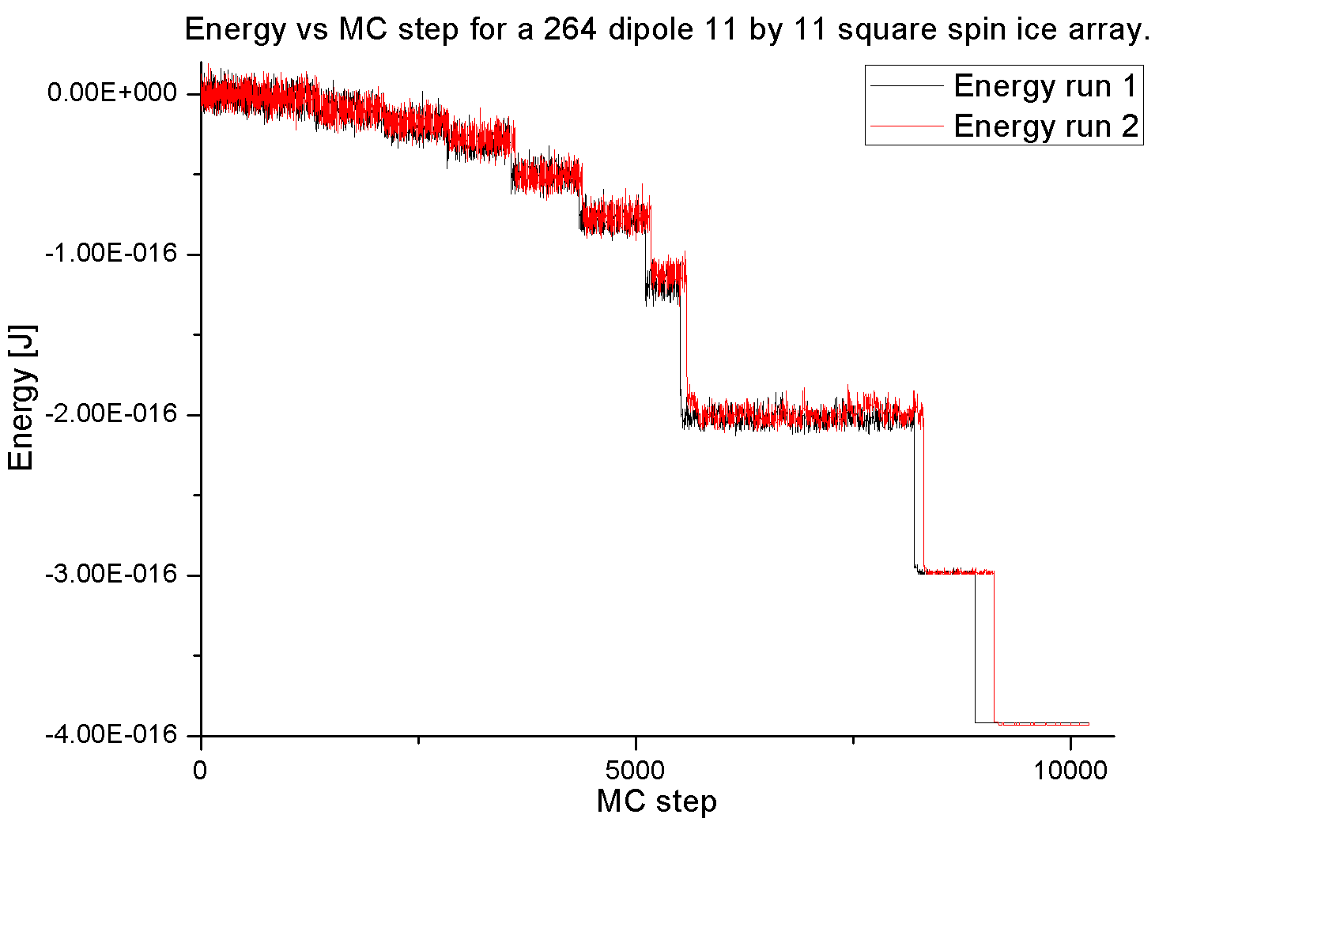
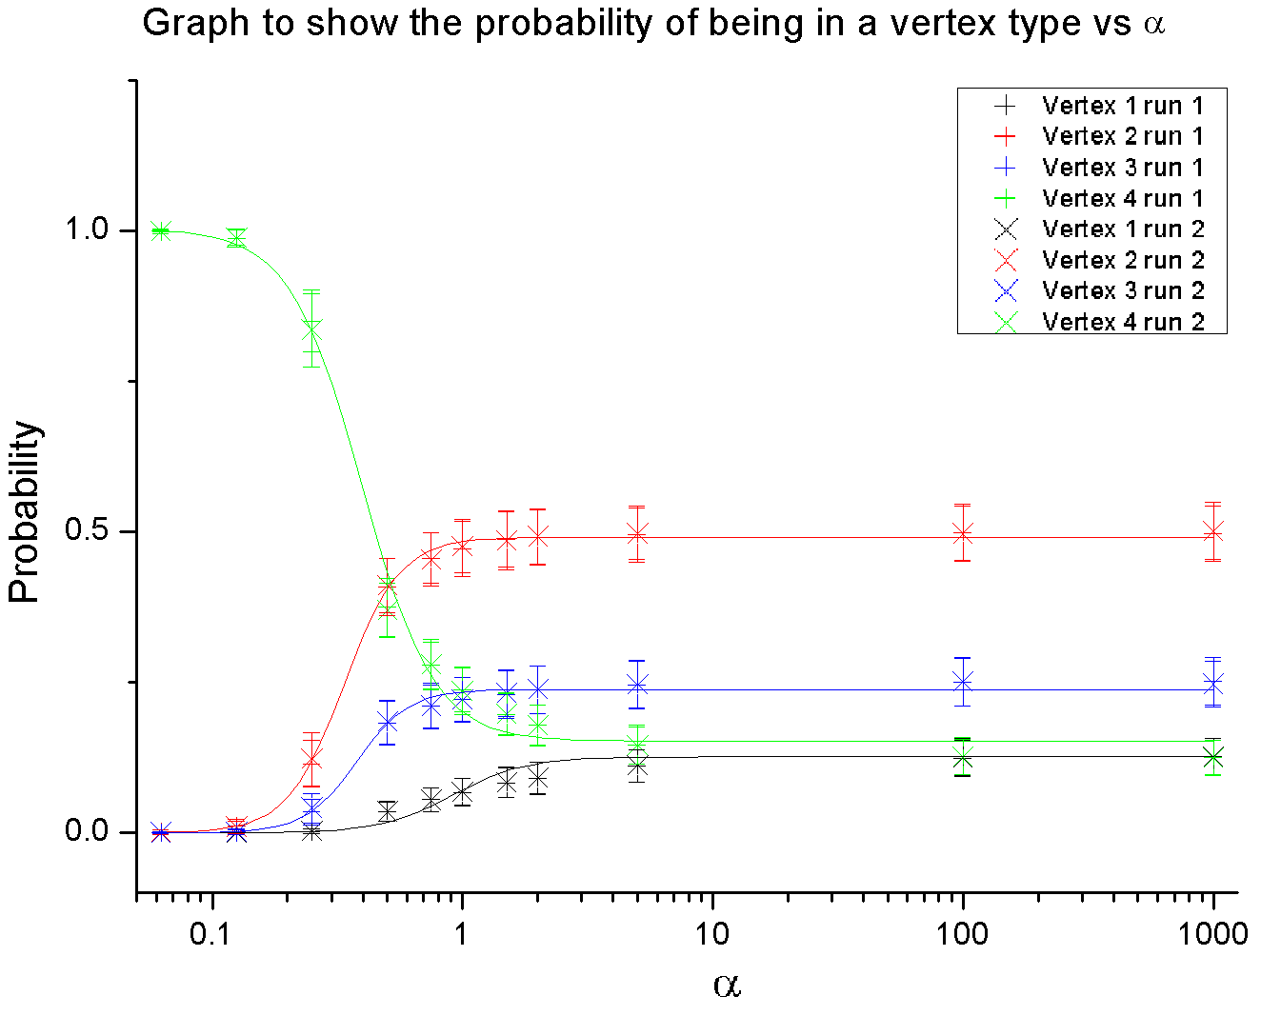
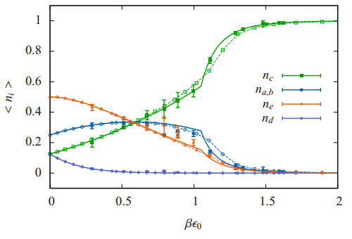
Square spin ice
Energy decent
Levis, D. and Cugliandolo, L.F.
Thermal phase transitions in Artificial Spin-Ice.
ArXiv e-prints
Feb 2003

Slide 22
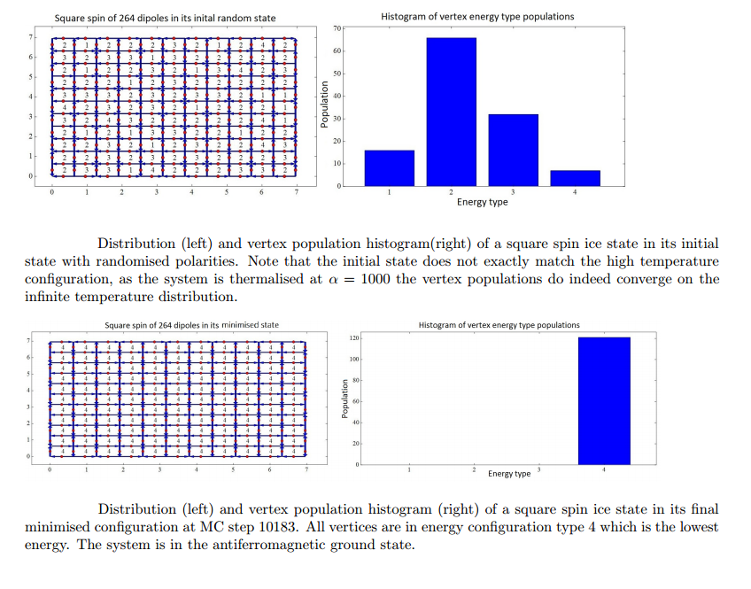
Square spin ice
Before and after

Slide 23
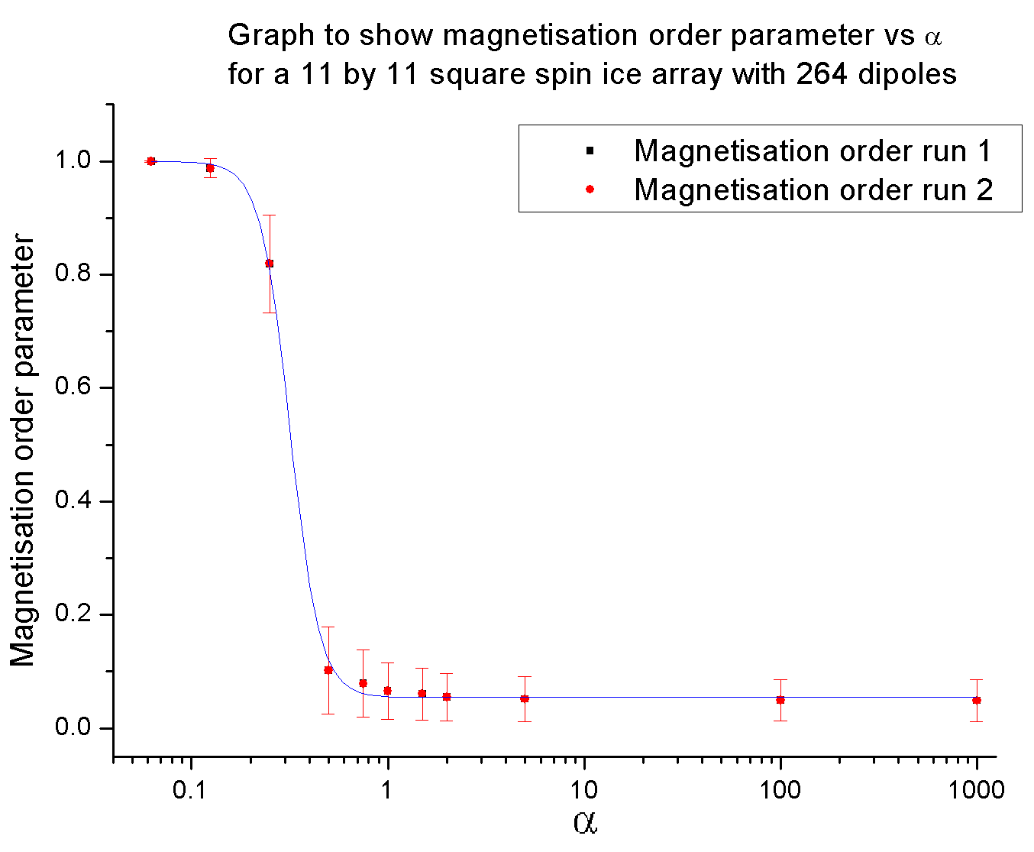
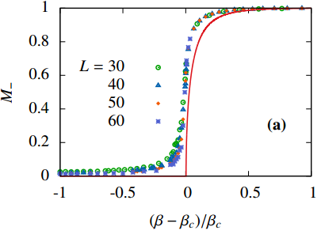
Square spin ice
Magnetisation order parameter
Levis, D. and Cugliandolo, L.F.
Thermal phase transitions in Artificial Spin-Ice.
ArXiv e-prints
Feb 2003

Slide 24
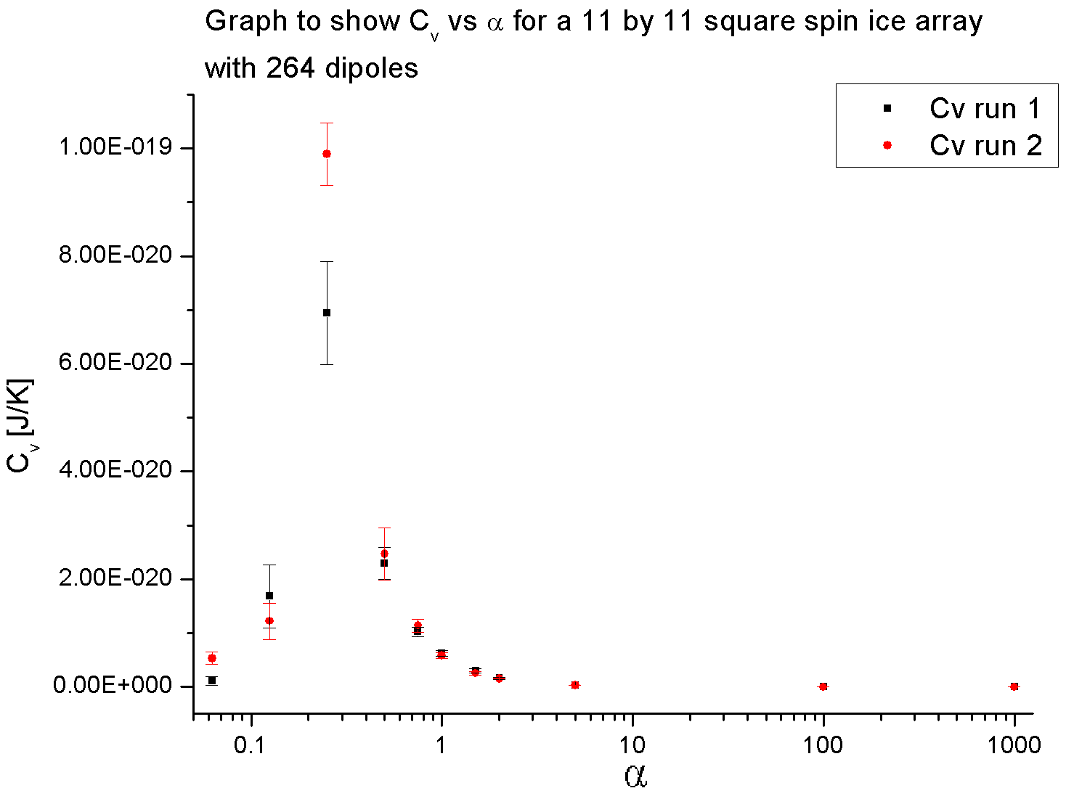
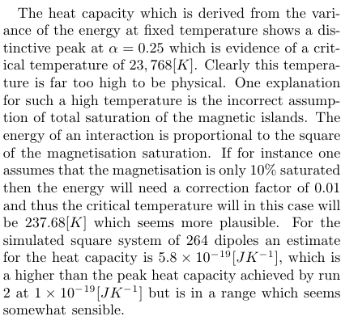
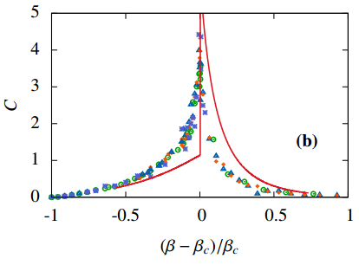
Square spin ice
Heat capacity
Levis, D. and Cugliandolo, L.F.
Thermal phase transitions in
Artificial Spin-Ice.
ArXiv e-prints,
Feb 2003

Slide 25
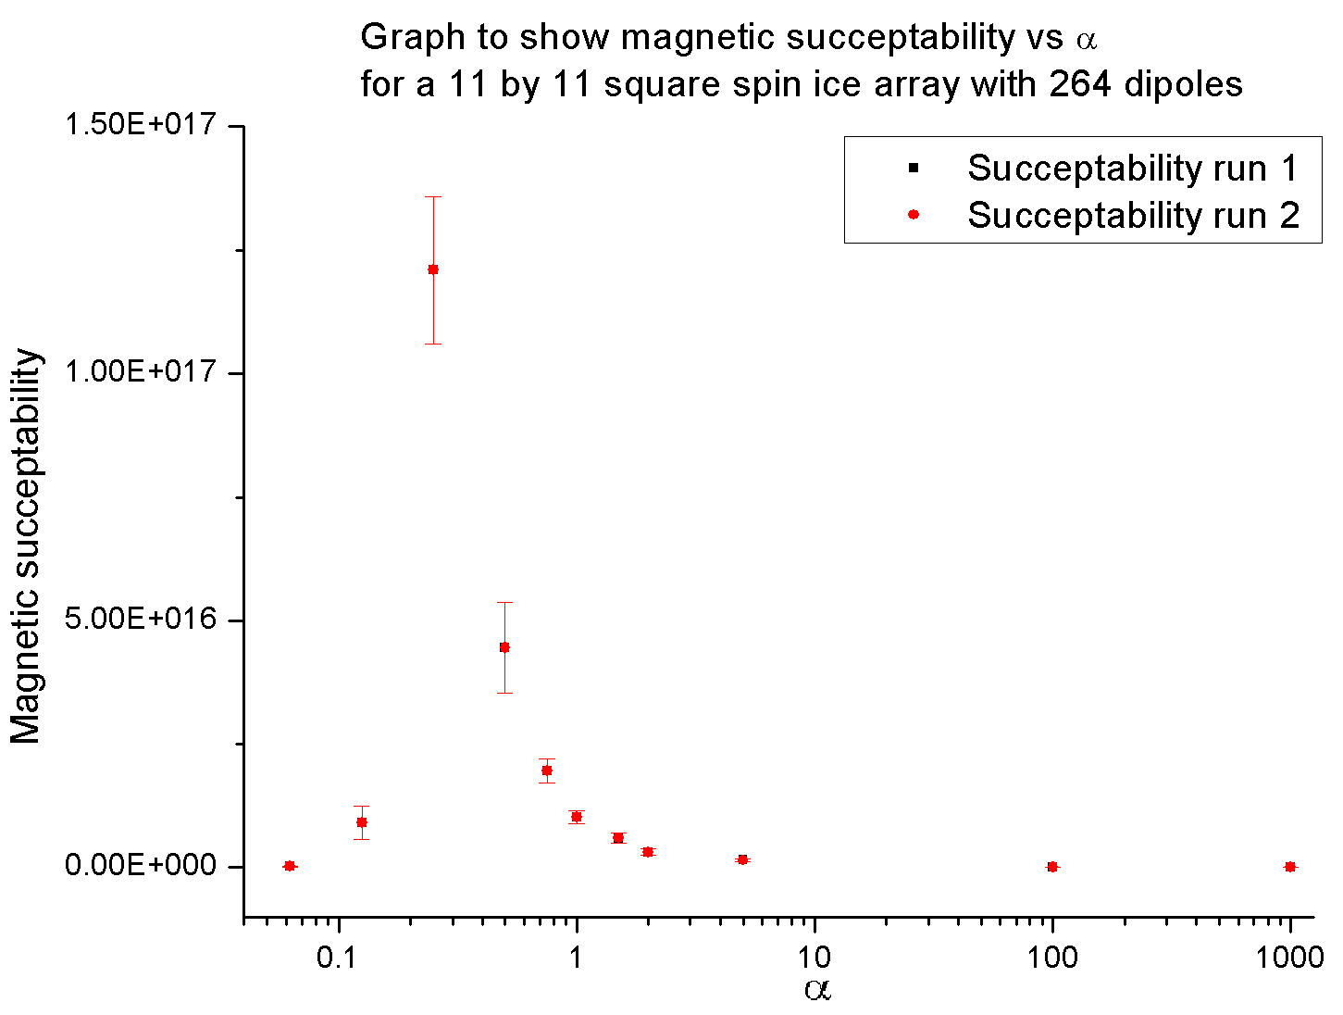
Square spin ice
Magnetic susceptibility

Slide 26
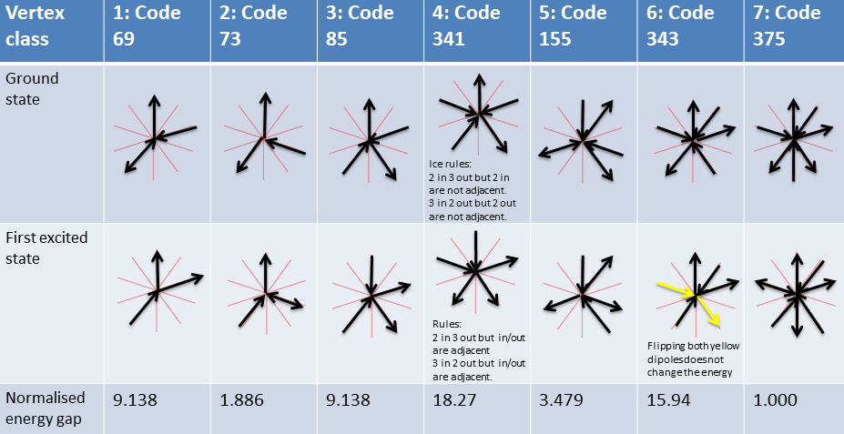
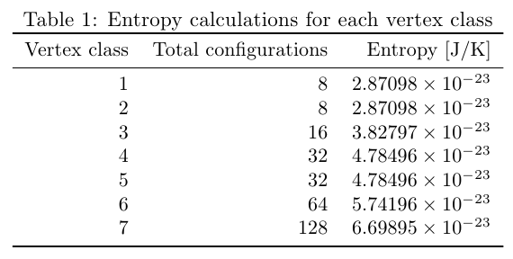
Penrose spin ice
Vertex classification
3,3,6,4,10,20,36

Slide 27
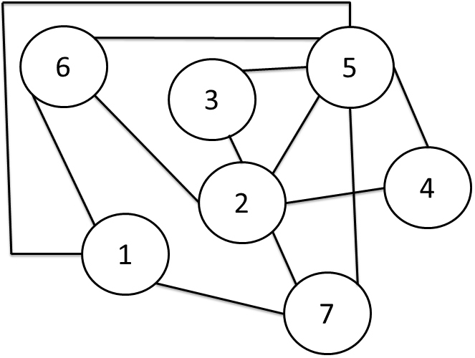
Penrose spin ice
Connection graph

Slide 28
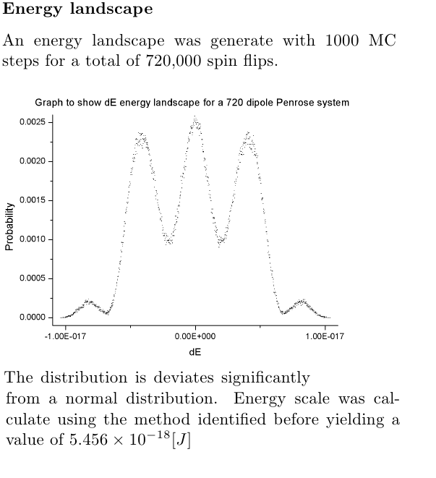
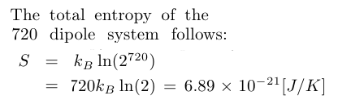
Penrose spin ice
720 dipole energy landscape

Slide 29
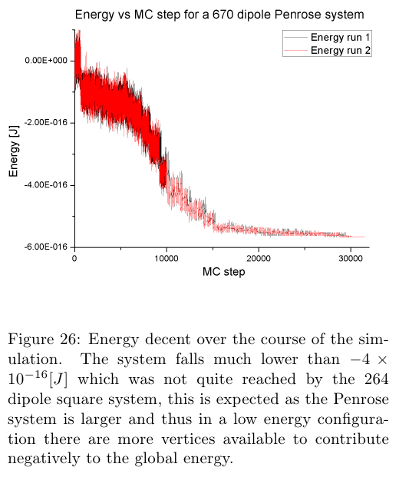
Penrose spin ice
720 dipole, energy decent
720

Slide 30
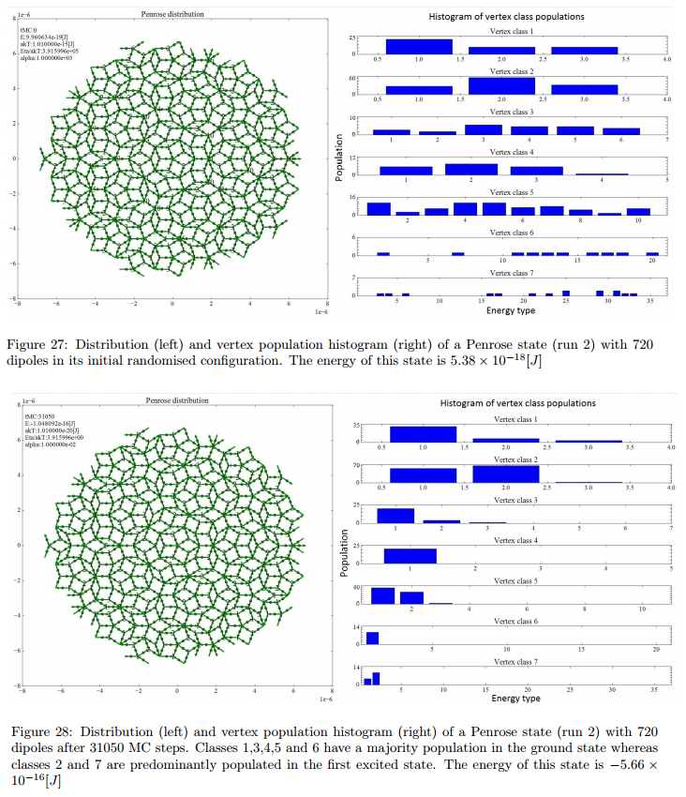
Penrose spin ice
720 dipole system. Before and after

Slide 31
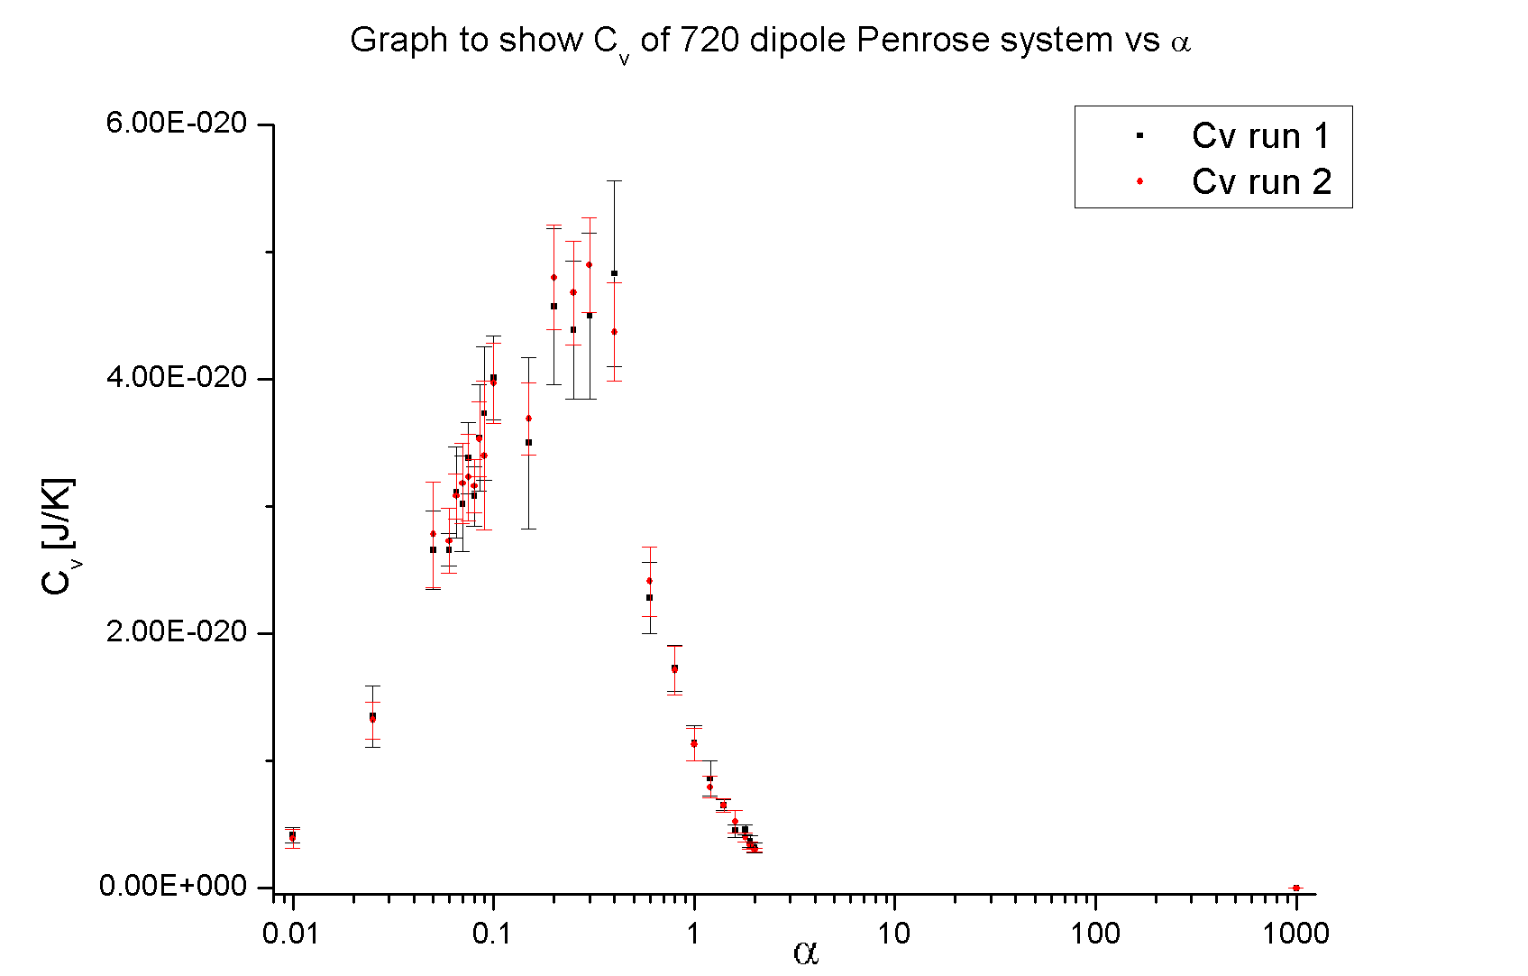
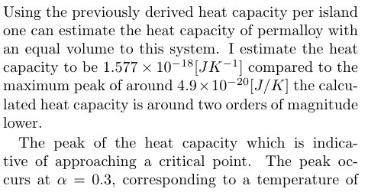
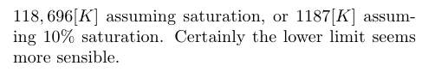
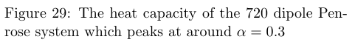
Penrose spin ice
720 dipole system. Heat Capacity

Slide 32
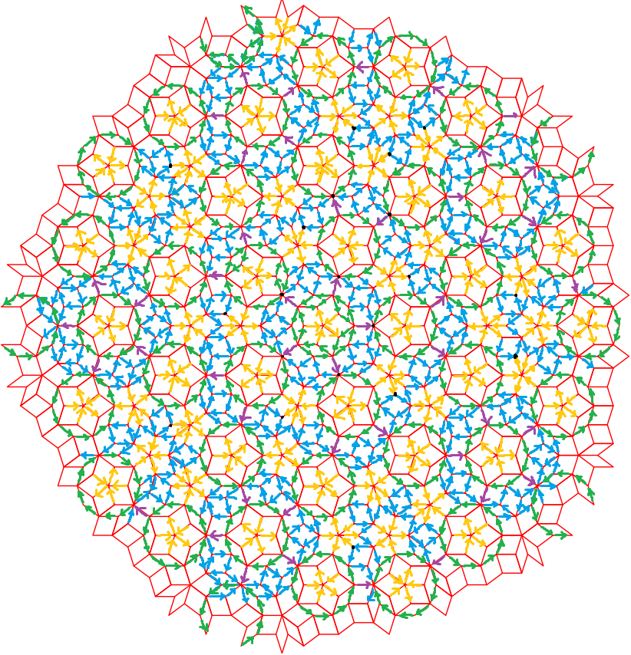
Penrose spin ice
Candidate ground state.
Image courtesy of Dong Shi

Slide 33
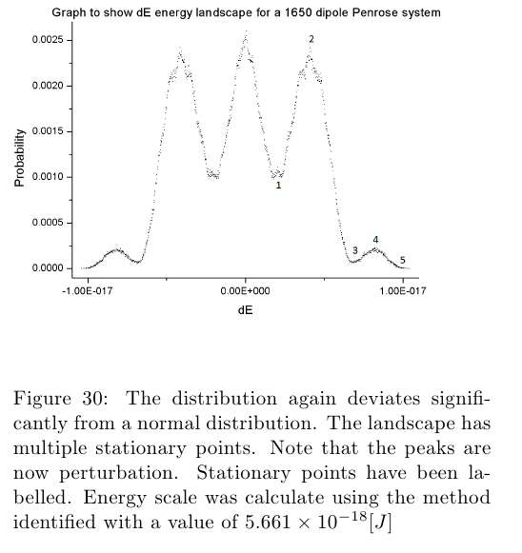
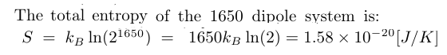
Penrose spin ice
1650 dipole energy landscape

Slide 34
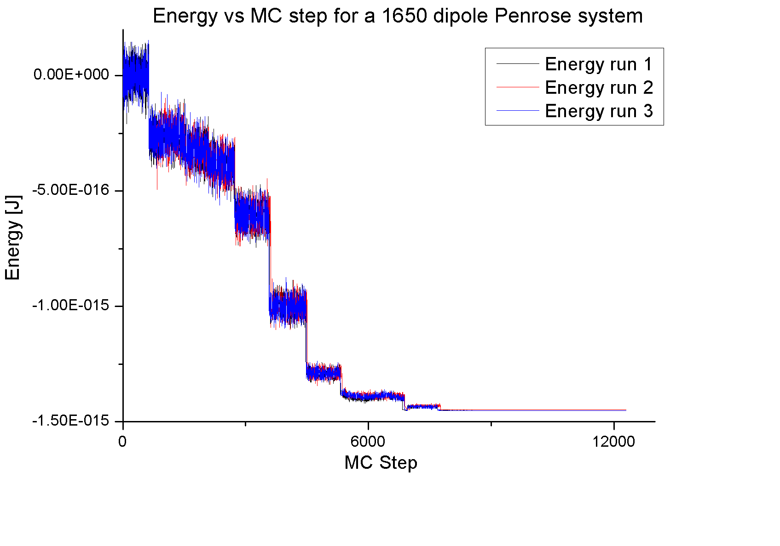
Penrose spin ice
1650 dipole energy decent

Slide 35
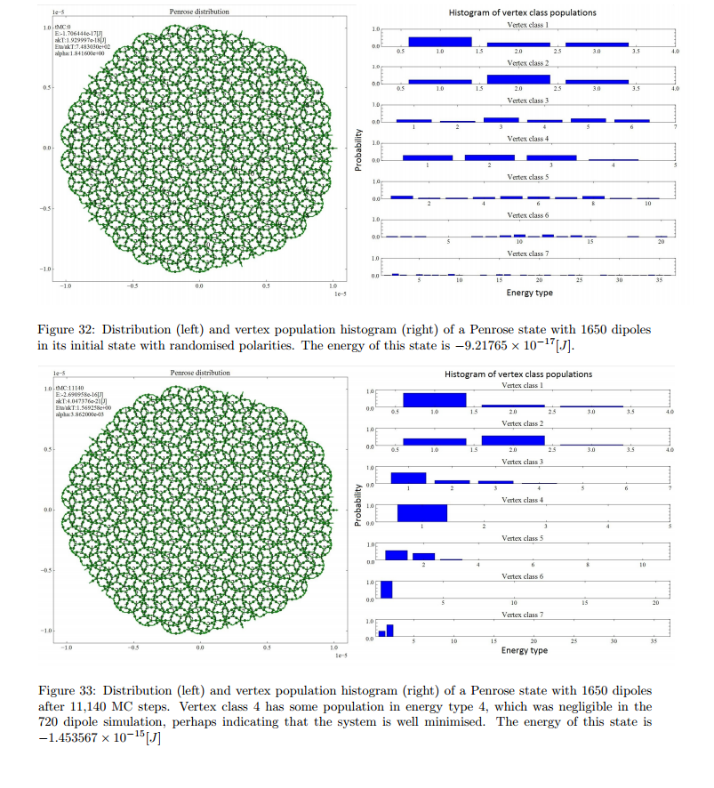
Penrose spin ice
1650 dipole system. Before and after

Slide 36
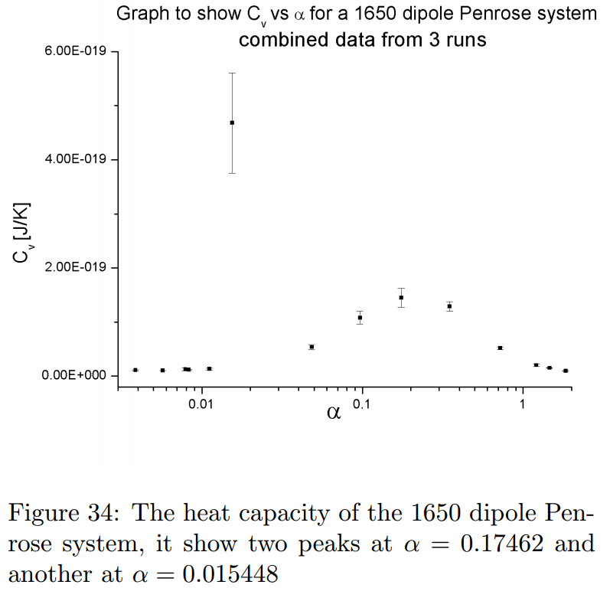
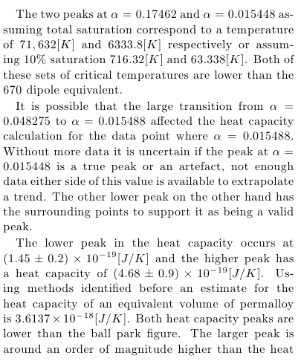

Penrose spin ice
1650 dipole system. Heat capacity

Slide 37


Penrose spin ice
1650 dipole system. Magnetisation order parameter
Image curtsy of Dong Shi

Slide 38

Penrose spin ice
1650 dipole system. Magnetic susceptibility

Slide 39

Penrose spin ice
Limited Monte Carlo

Slide 40


Penrose spin ice
Limited MC energy decent

Slide 41



Penrose spin ice
Vertex populations
Vertex class populations 1,3,5 and 7 were fixed by setting
the skeleton mask. Vertex classes 1,3 and 5 are found
in the ground state with populations 110, 65
and 180 respectively. Vertex class 7 is in the 1st ex-
cited state with population 50. The remaining three
vertices 2,4 and 6 vary over the course of the simula-
tion.
Over the course of the simulation, the population
of vertex class 2 converges to have 110 members in
the ground state and 185 in the 1st excited state.
Furthermore vertex class 4 has all 46 members in the
ground state, while vertex class 6 has all 20 members
in the ground state.

Slide 42

Penrose spin ice
Before

Slide 43

Penrose spin ice
After

Slide 44

Penrose spin ice
After

Slide 45
Penrose-platter spin ices
Conclusions
What I have learnt:
Vertex populations of the ground state.
Significance of long-range interactions.
What could be done better next time:
Longer simulation times.
More real-time statistical analysis.
Find the true moment!

Slide 46
Penrose-platter spin ices
Questions
?

Slide 47


School of something
FACULTY OF OTHER
Appendix

Slide 48

Projection method
Crystallography of quasi-crystals,
Janssen T.,
Acta Crystallographica,
Section A: Foundations of
Crystallography,
Volume 42,
Pages 261--271,
1986

Slide 49


School of something
FACULTY OF OTHER
Appendix

Slide 50
Software
MC Process
Tiler
Distribution
Interactions
Monte Carlo

